Slide 1
Google Slides
Yojas Sudhir Shetye
FYIT
Roll_no = 137

Slide 2
Key points-
Introduction
Working
Usage
Features

Slide 3
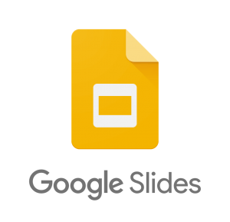
1) Introduction
Google Slides is a presentation program included as part of the free,web-based Google Docs Editors suite offered by Google.
The app allows users to create and edit files online while collaborating with other users in real-time.
An editor's position is highlighted with an editor-specific color and cursor and a permissions system regulates what users can do. Updates have introduced features using machine learning, including "Explore", offering suggested layouts and images for presentations, and "Action items", allowing users to assign tasks to other users

Slide 4
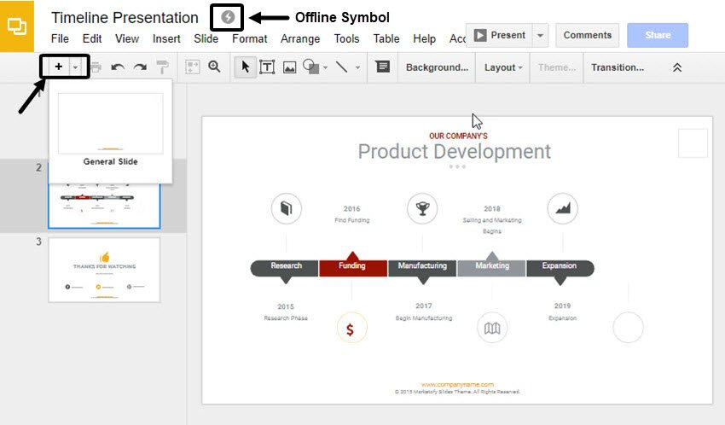
2) Working
1. To create a new presentation:
Open the Slides home screen at slides.google.com.
In the top left, under "Start a new presentation," click New ‘+’ . This will create and open your new presentation.
Edit and format presentation:
3. You can share files and folders with people and choose whether they can view, edit, or comment on them.

Slide 5
3) Use
By using google slides we can even publish presentations on the web.
To run google slides in offline mode, you have to install Google Docs Offline, a chrome extension that allows users to use google slides in offline mode.
The Google Slides app is available free of charge to individuals but also as part of Google's GSuite business center program, a monthly subscription that provides additional business-oriented features.
It is available in 83 languages.
google slides automatically save the files and give the name 'untitled presentations' so that when you open google slide you will get them back.
Google Slide provides seamless integration with google font.
Google Slide has voice typing features and you can use it for typing on the slides while speaking

Slide 6
4) Features
1)_Features
Slides serves as a collaborative tool for cooperative editing of presentations in real-time. Presentations can be shared, opened, and edited by multiple users simultaneously and users are able to see slide-by-slide and character-by-character changes as other collaborators make edits. Changes are automatically saved to Google's servers.
An editor's current position is represented with an editor-specific color/cursor, so if another editor happens to be viewing the same slide, they can see edits as they occur. A sidebar chat functionality allows collaborators to discuss edits. The revision history allows users to see the additions made to a document, with each author distinguished by color. Only adjacent revisions can be compared, and users cannot control how frequently revisions are saved.
2)_Action items
In October 2016, Google announced the addition of "action items" to Slides. If a user writes the name of a person the presentation is shared within a comment, the service will intelligently assign that action to the person. Google states this will make it easier for other collaborators to see who is responsible for individual tasks. When a user visits Google Sheets or any of the other Google Drive applications, any files with tasks assigned to them will be highlighted with a badge.
3)_Offline editing
In order to view and edit presentations offline, users need to be using the Google Chrome web browser. A Chrome extension, Google Docs Offline, allows users to enable offline support for Slides files on the Google Drive website. The Android and iOS apps natively support offline editing.

Slide 7
5) Additional Features
1 Capable of inserting images, structured documents, animations, and transitions in slides.
2 It has a variety of templates located at the right sidebar.
3 Create, arrange and customize, apply animation to your slides.
4 Share, add comments, replies to files. Currently, we can share via Gmail, Twitter, and Facebook.
5 It also has features of chatting with people directly.
6 Can print and download files in various formats.
7 Google Slides can access your calendar, notes, and tasks.
8 Slides get automatically saved in google drive so no problem with your slides files even if your system crashes.
9 Supported file types: .ppt, .pptx, .pptm, .pps, .ppsx, .ppsm, .pot, .potx, .potm.
10 Compatible with Microsoft Powerpoint: We can save this file in ppt format and then open the same ppt files in
windows powerpoint. So, we can say google slides are compatible with windows powerpoint.

Slide 8
Thank you ☺

